Slide 1
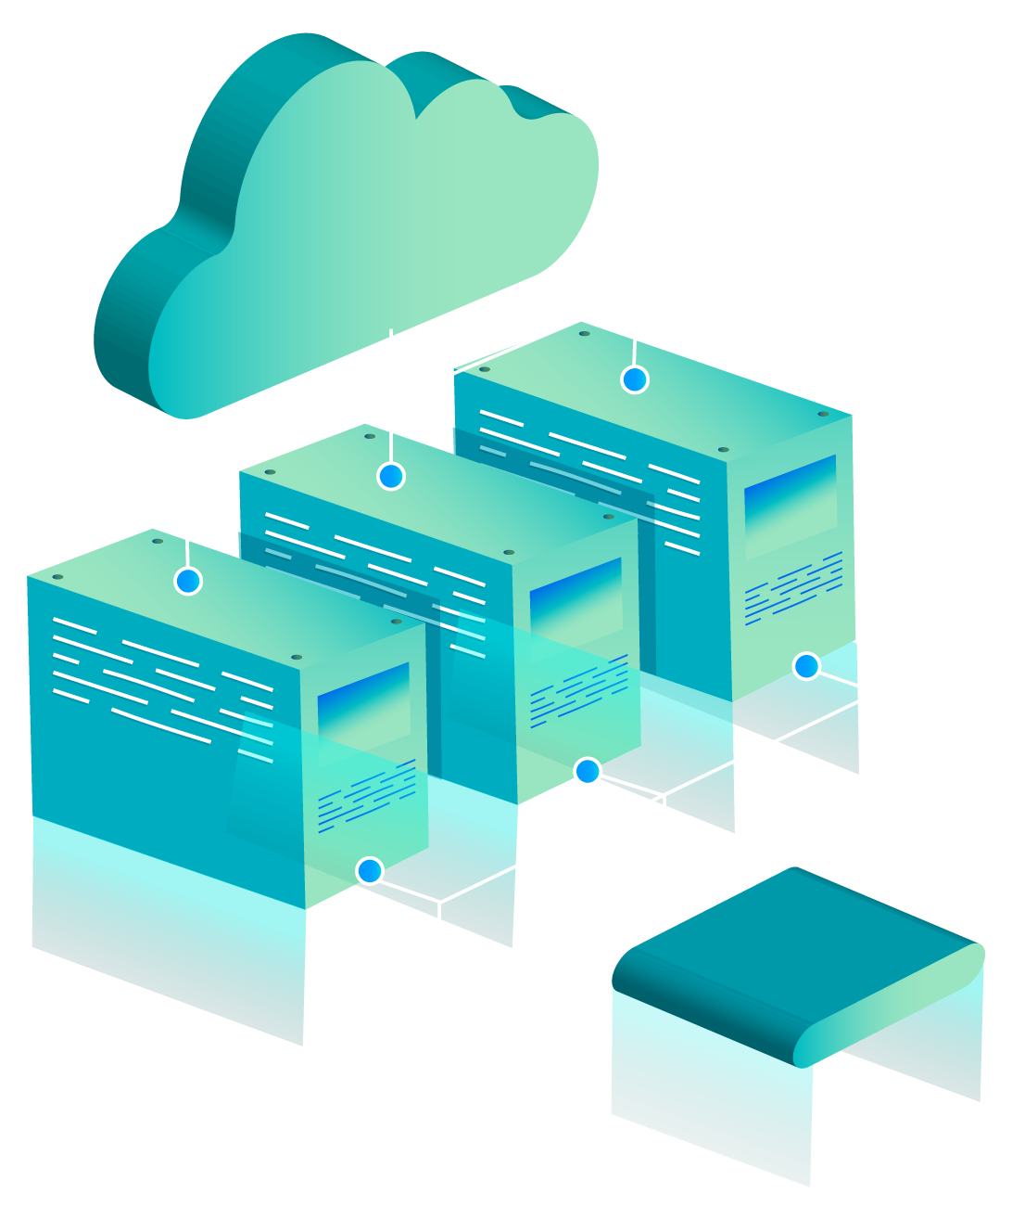
PRICE DRIFT DETECTOR
AWS CLOUD PROJECT
Am I being charged correctly?
Presented By:
Alisha Rao E016
Sanaz Katpitia E020
Snigdha Mishra E036

Slide 2
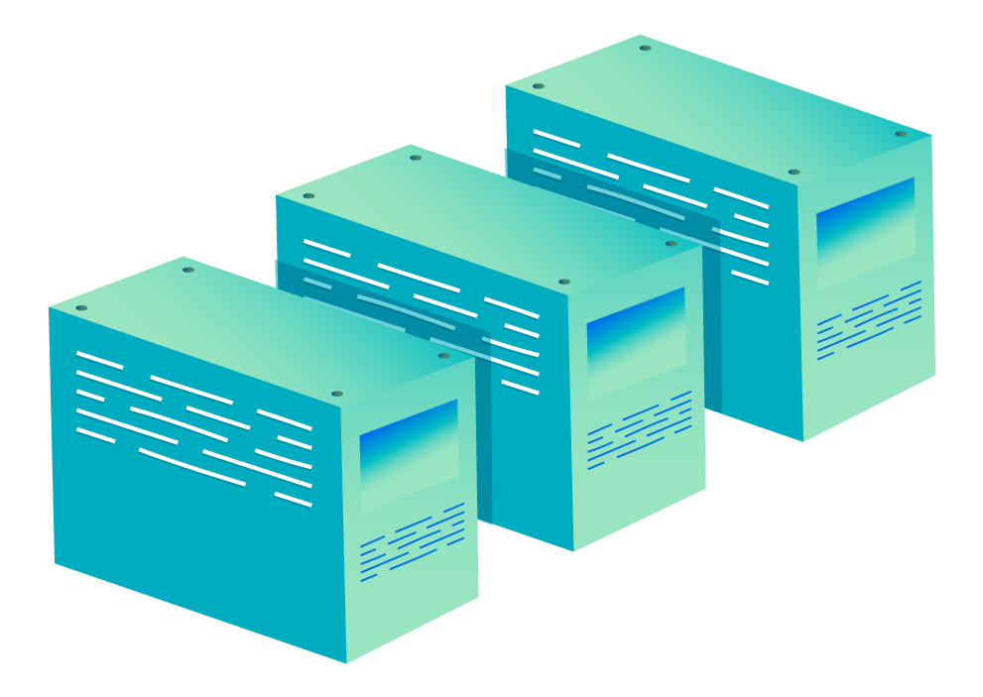
THE PROBLEM
Subscription prices change quietly
No clear notice before a hike
Same price, smaller plan
Too many services to track by hand
We built an automatic watchdog

Slide 3
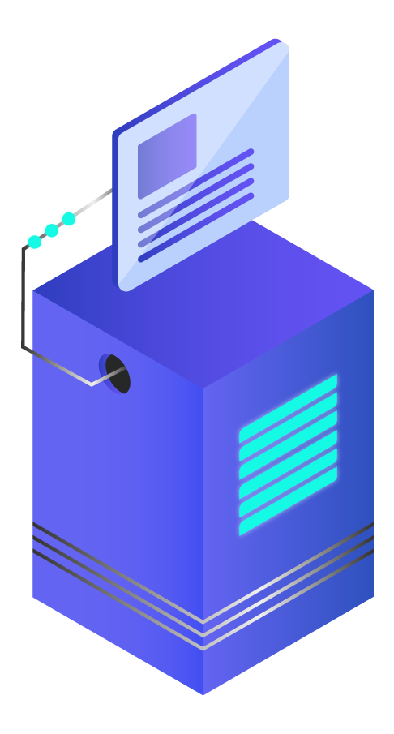
INTRODUCTION
Every day, AWS scrapes subscription prices, stores the history, flags stealth hikes and emails us. A live dashboard shows it all.

Slide 4
HOW IT WORKS
COLLECT
STORE
DETECT
Scrape 6 services daily into S3
Load every file into DynamoDB
Flag hikes, email, dashboard

Slide 5
SERVICES WE USED
S3
Lambda
EventBridge
DynamoDB
Athena
SNS
Storage
All the code
Daily schedule
Price + alert tables
SQL analysis
Email alerts

Slide 6
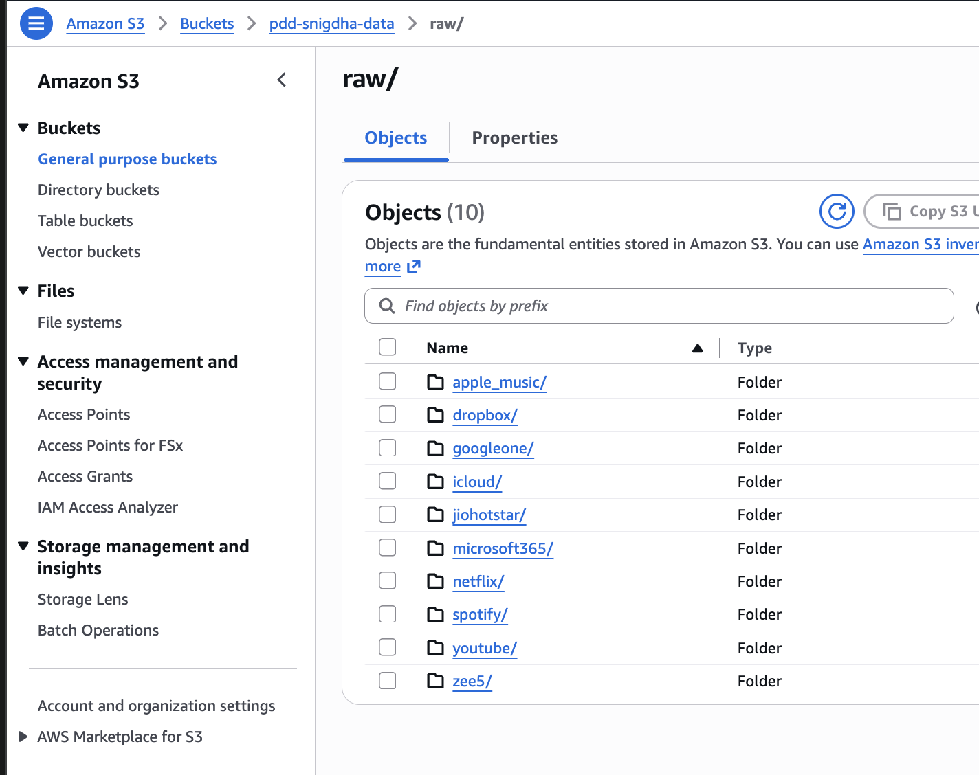
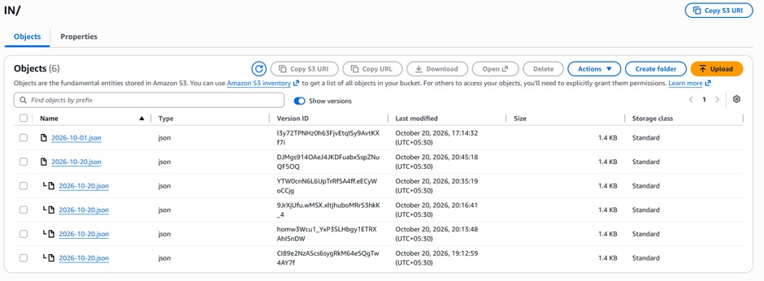
AMAZON S3
WHAT WE DID
Stored 425 history files
New snapshot every day per service
Holds config and daily exports

Slide 7
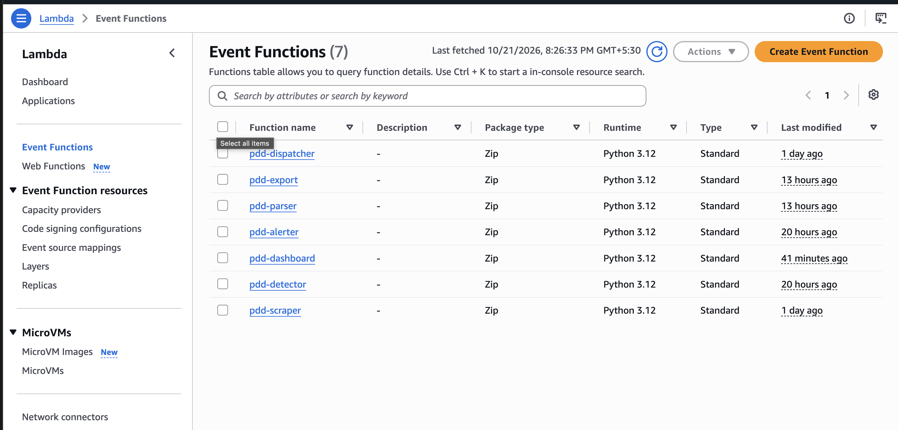
AWS LAMBDA
WHAT WE DID
7 functions, no servers
Scraper runs our Python code
Parser, detector, alerter, dashboard

Slide 8
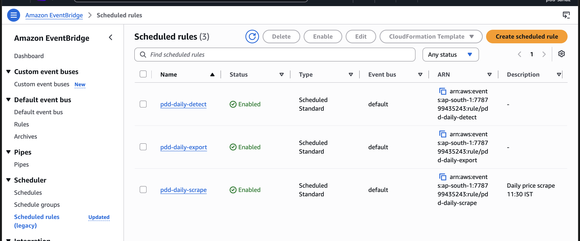
EVENTBRIDGE
WHAT WE DID
Scrape at 11:30 IST
Detect at 11:45, export at 12:00
Runs daily with nobody logged in

Slide 9
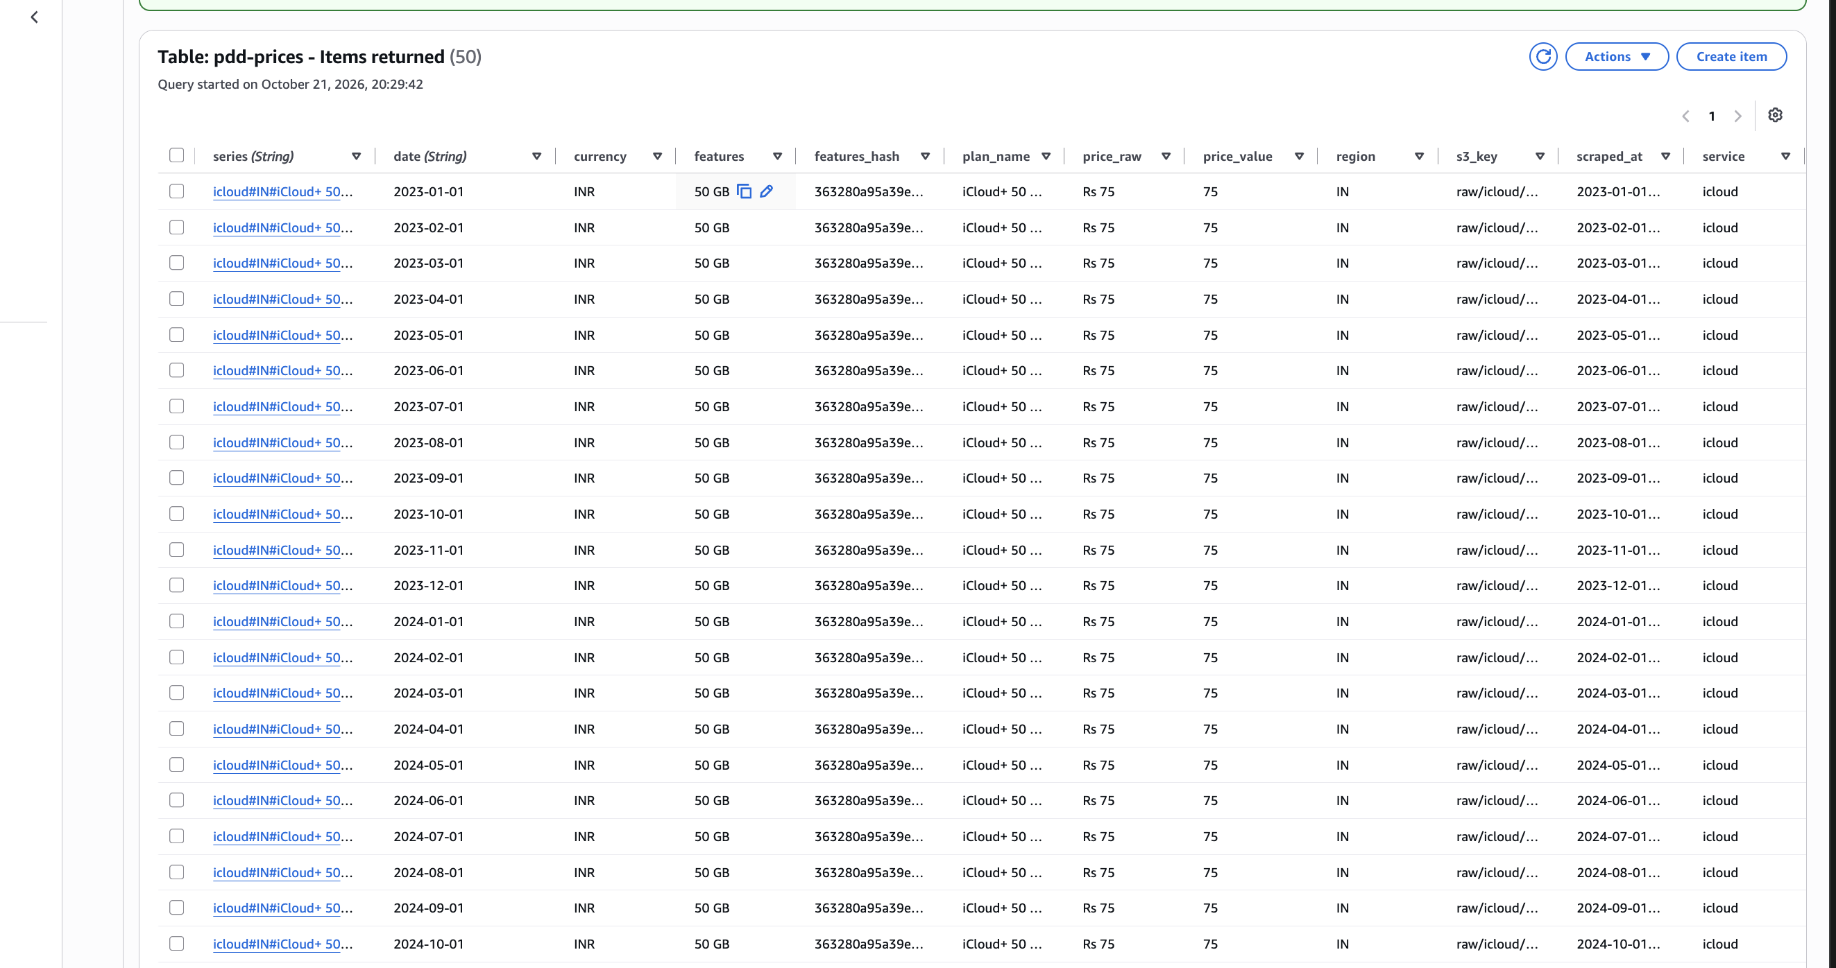
DYNAMODB
WHAT WE DID
One row per plan per day
S3 trigger loads files in seconds
Separate table for alerts

Slide 10
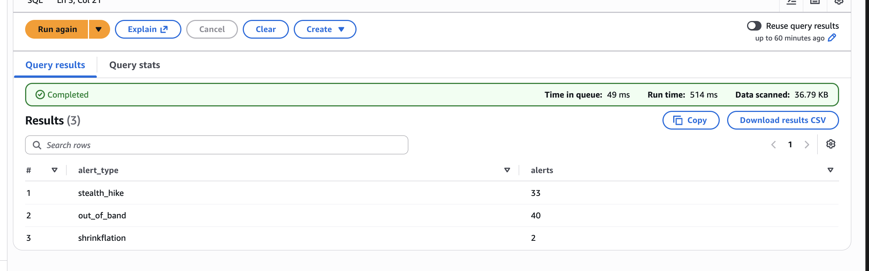
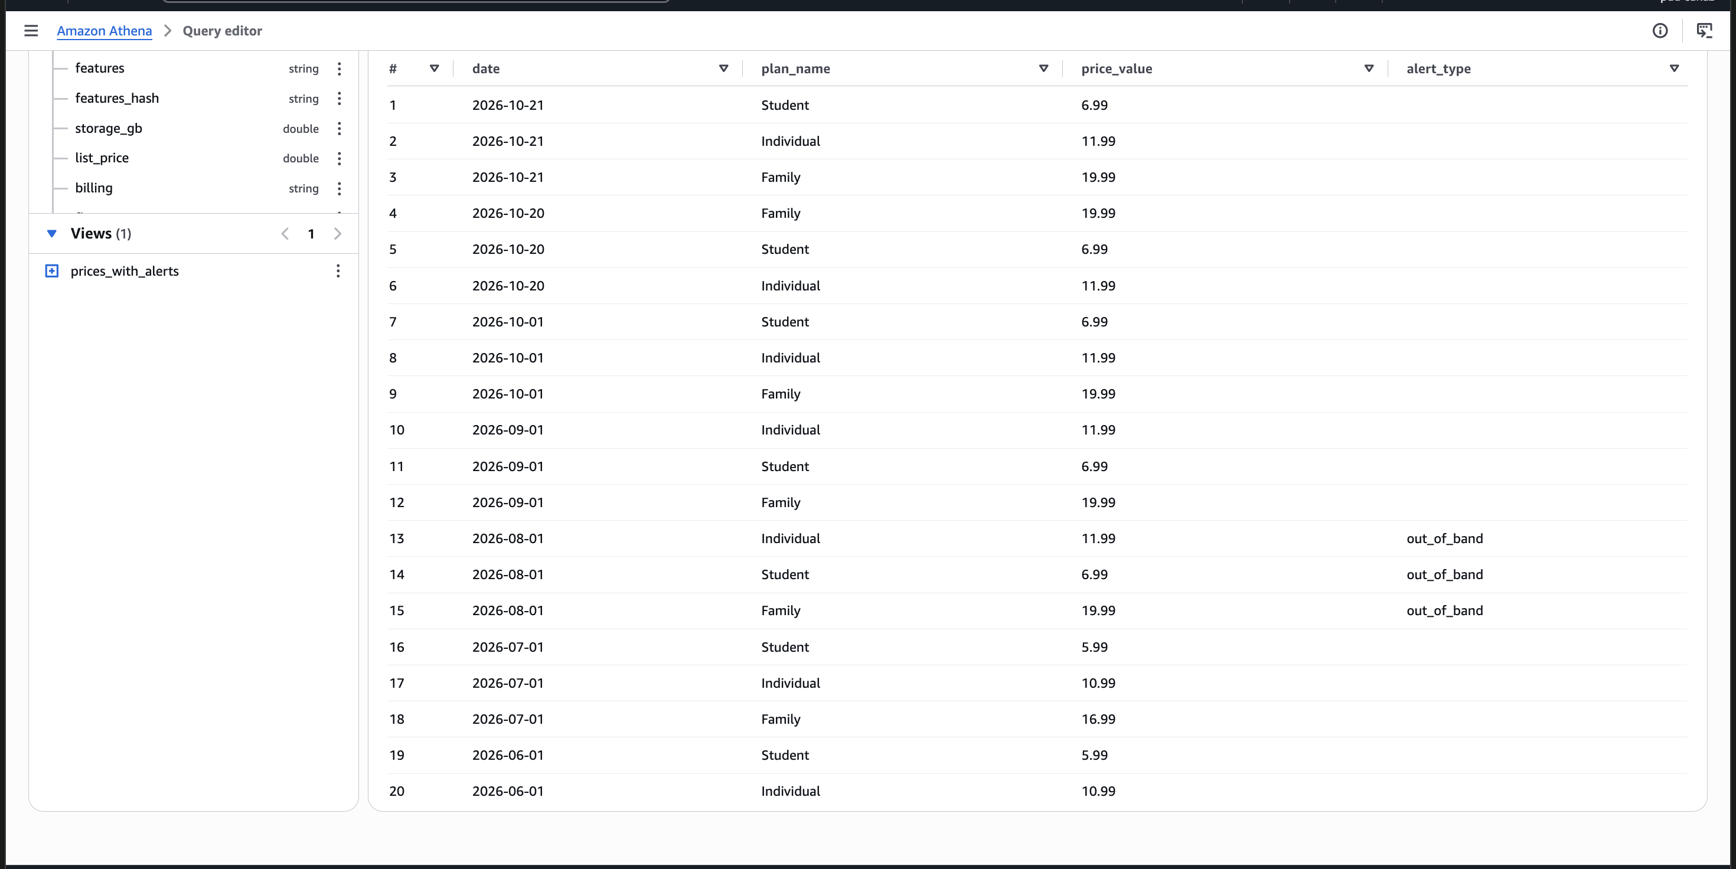
AMAZON ATHENA
WHAT WE DID
SQL on the daily exports
Prices and alerts tables
Joined view for analysis

Slide 11
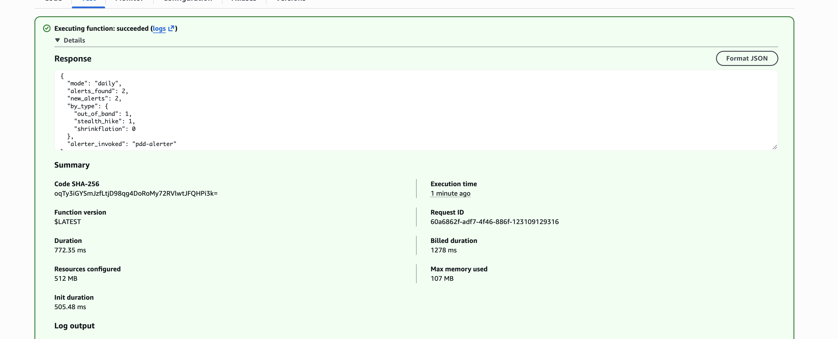
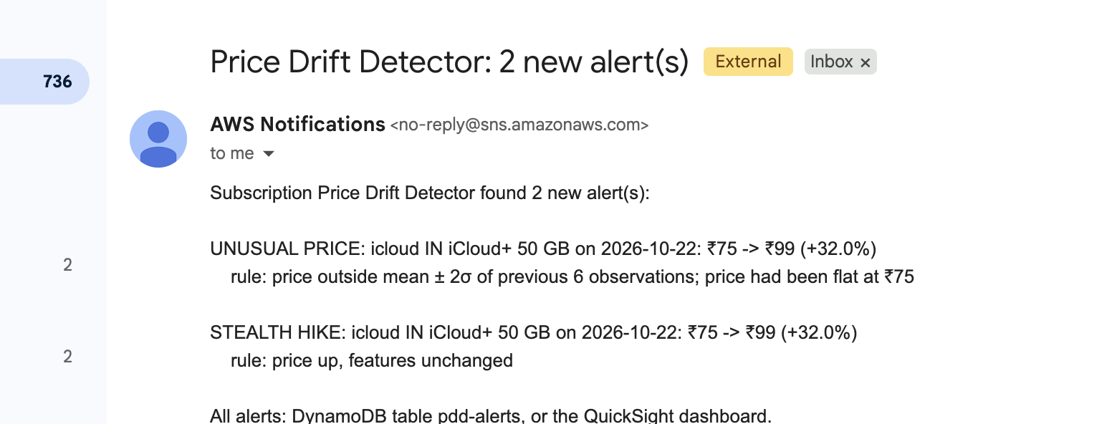
AMAZON SNS
WHAT WE DID
Emails the team on new hikes
Old alerts never re-sent
Tested with a fake price hike

Slide 12
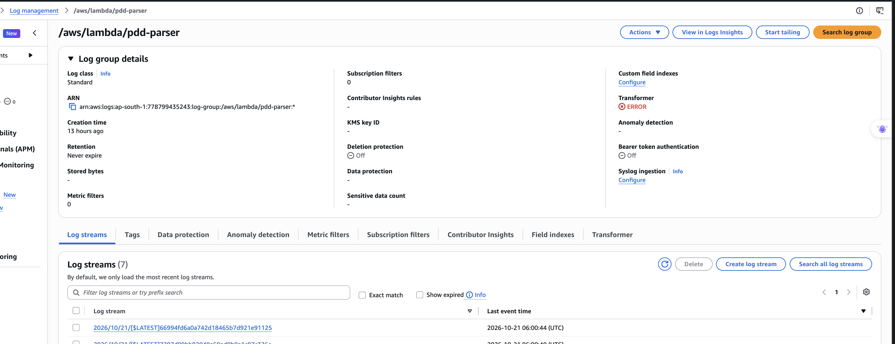
CLOUDWATCH
WHAT WE DID
Logs every Lambda run
Used to debug errors
Proves the daily runs worked

Slide 13
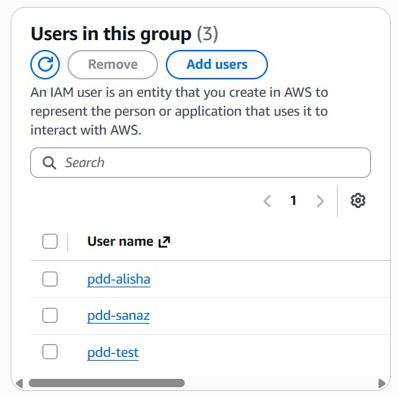
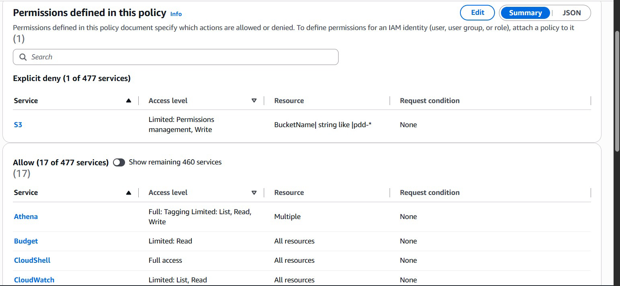
AWS IAM
WHAT WE DID
One shared role for all Lambdas
Team limited to pdd- resources
Owner keeps billing control

Slide 14
THREE WAYS YOU GET OVERCHARGED
Stealth hike
Shrinkflation
Unusual price
Price up, plan unchanged.
Test: iCloud+ 50 GB ₹75 → ₹99, still 50 GB
Same price, less product.
Dropbox US Standard: $15, less storage (Jul 2026)
A jump outside the plan's normal range.
Apple Music US $10.99 → $11.99 (Aug 2026)

Slide 15
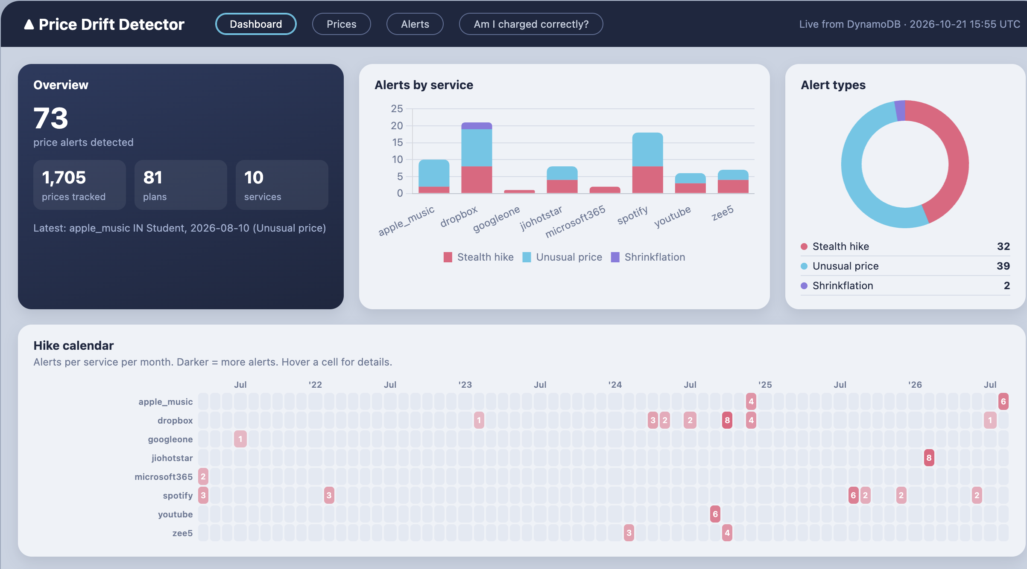
LIVE DASHBOARD
A Lambda web page reading DynamoDB live.
Link: https://iur7snxolluoqpz2w6rkfdanmi0qqfxq.lambda-url.ap-south-1.on.aws/

Slide 16

THANK YOU!

